Slide 1



ERAU
Start
GD358
VARIABLE WHITE DWARF
Confirming the non-radial g (gravity)-mode Pulsations in GD 358
Course:
OBSERVATIONAL ASTRONOMY
By:
JACOB ROMEO & LAINA TALLMAN

Slide 2
ERAU
EP425 | VARIABLE WHITE DWARF GD358
00
OVERVIEW
01
02
03
ABSTRACT
MOTIVATION
OBSERVATIONAL STRATEGY & DATA ANALYSIS
04
05-07
08
FINDER CHART
AMPLITUDE SPECTRUMS
TIME SERIES
09
10
11
DISCUSSION OF RESULTS
CONCLUSION AND FURTHER WORK
REFERENCES
Notes:
Laina start

Slide 3
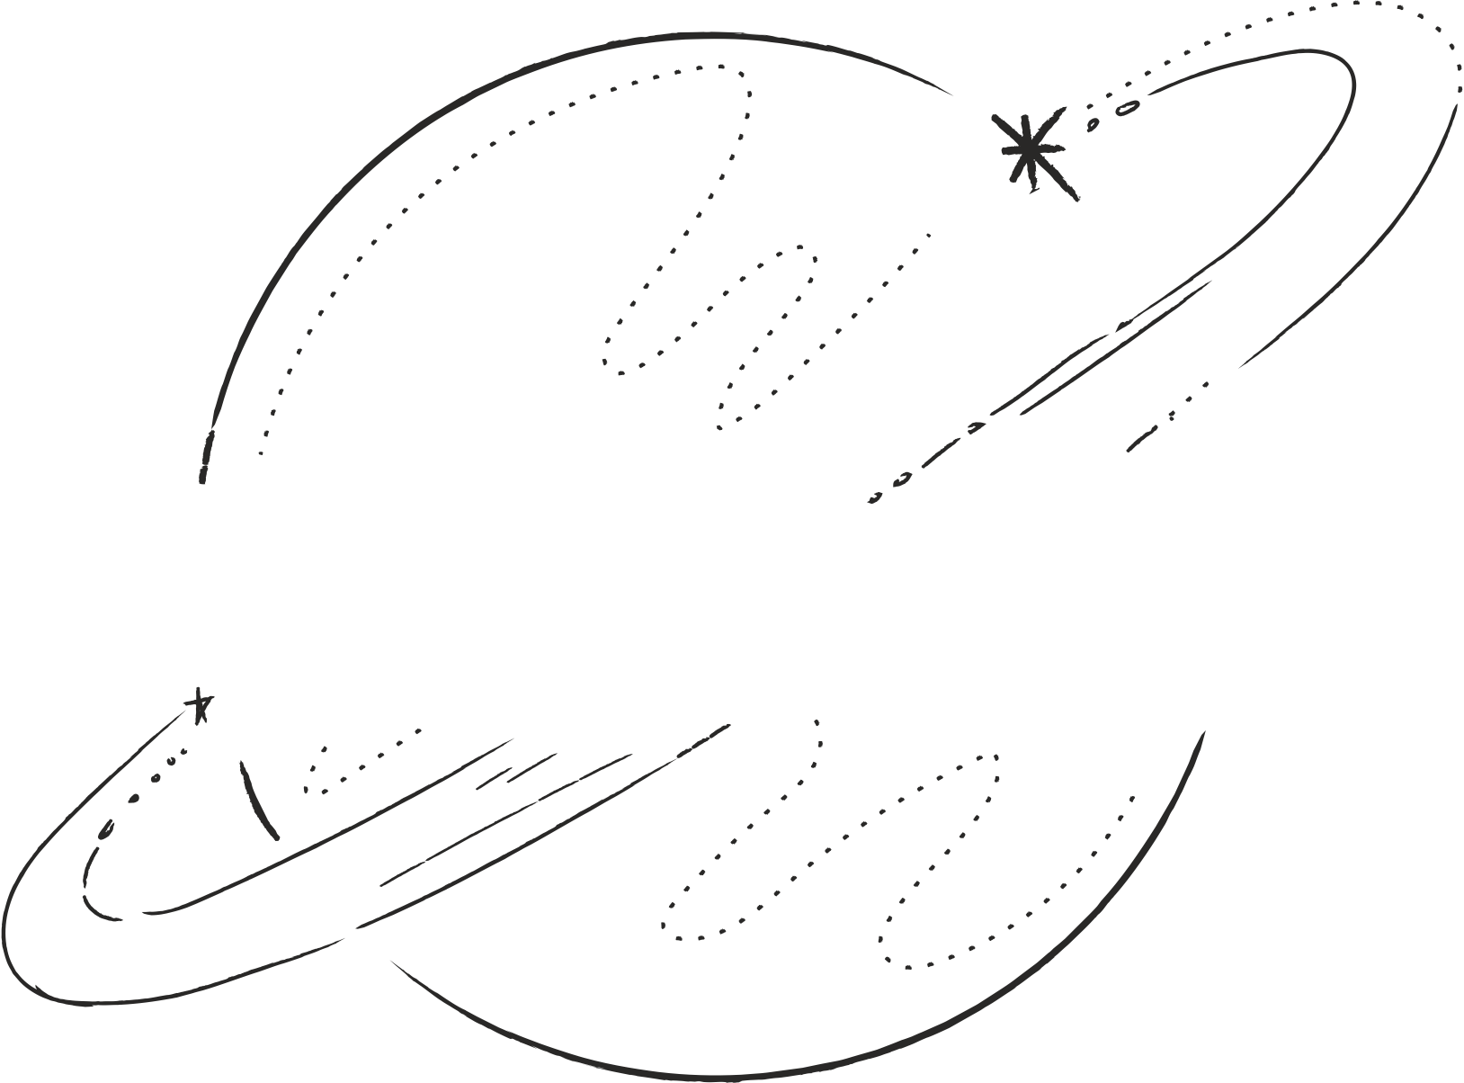
ERAU
EP425 | VARIABLE WHITE DWARF GD358
01
ABSTRACT
Pulsating White Dwarfs (PWD) as Astronomical Tools: PWD stars, like GD 358, offer insights through nonradial g-mode pulsations.
Utilizing ERAU's 1-meter observatory, we aim to confirm oscillation frequencies of GD 358.
Data processed using AstroImageJ for calibration and differential photometry, and Fourier Analysis with Period04.
Period ~ 697.8s
Frequency ~ 1.3mHz
Amplitude ~ 38.4mmag

Slide 4
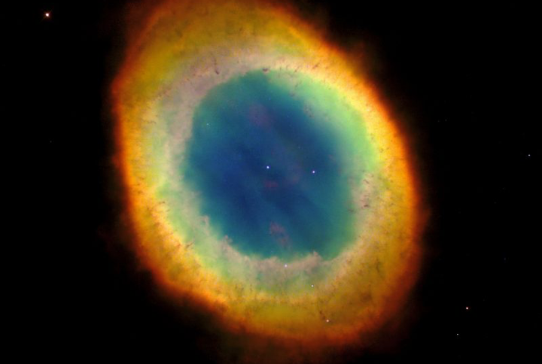
ERAU
EP425 | VARIABLE WHITE DWARF GD358
02
MOTIVATION
Confirm the non-radial g mode pulsations in GD358.
GD358 was chosen because of its above average magnitude relative to its White Dwarf companions.
White Dwarf pulsations provide insights int the equations of state governing matter under extreme conditions.
History of research with Dr. Gillam on rapidly oscillating Ap stars.
The Ring Nebula M57 with a white dwarf in the middle. Its lighting up the receding cloud of gas.
Source: earth sky.org
Notes:
Laina end Jacob Start

Slide 5
ERAU
EP425 | VARIABLE WHITE DWARF GD358
02
OBSERVATIONAL STRATEGY AND DATA ANALYSIS
Utilized a Charge Coupled Device (CCD) for data acquisition.
Observational Constraints:
Selected days were unaffected by the moon.
4 unsuccessful nights due to humidity.
Scheduled observing nights based on GD 358's rise times, providing 3-6 hours of observing per night between February and April.
60 second exposures
G filter
Employed AstroImageJ for differential photometry and Period04 for Fourier Analysis.

Slide 6
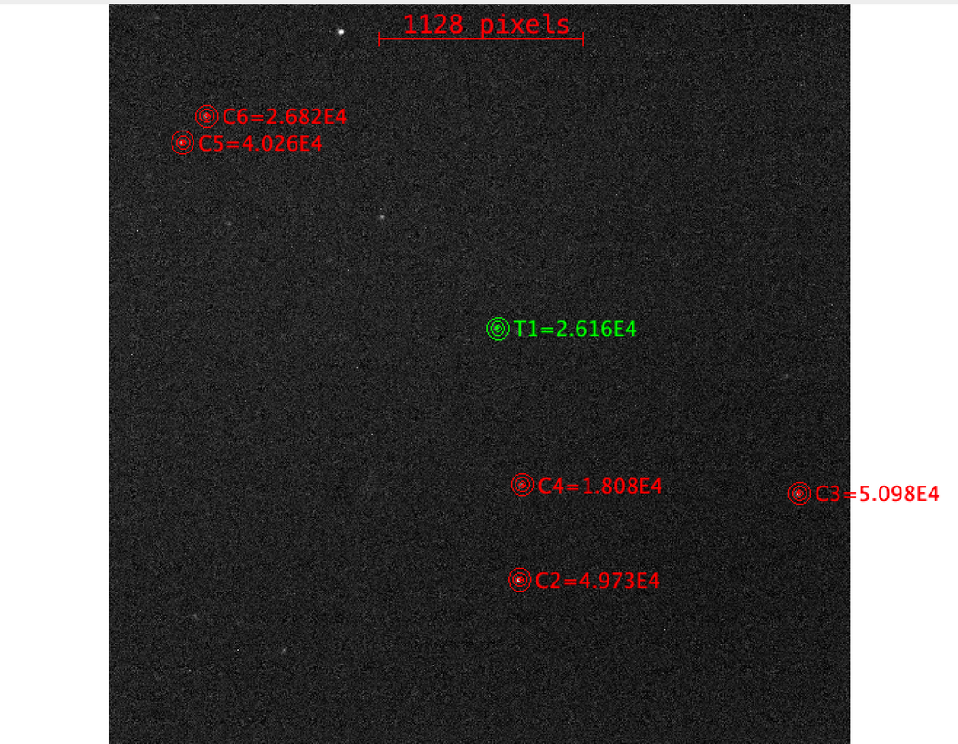
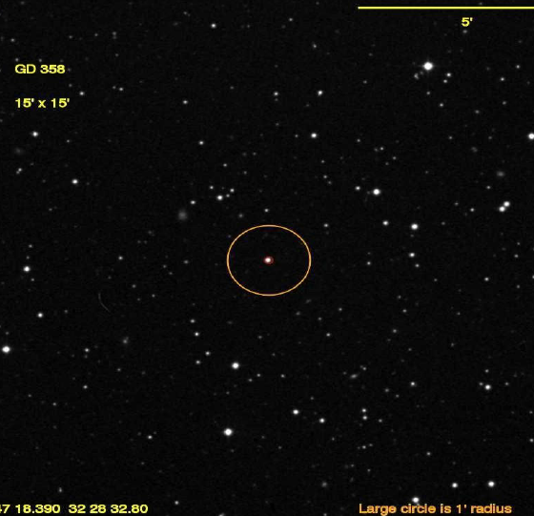
ERAU
EP425 | VARIABLE WHITE DWARF GD358
04
FINDER CHART
The Finder chart for GD 358 in the constellation Hercules, with an apparent magnitude of 13.65 and spectral type DBV [8].

Slide 7
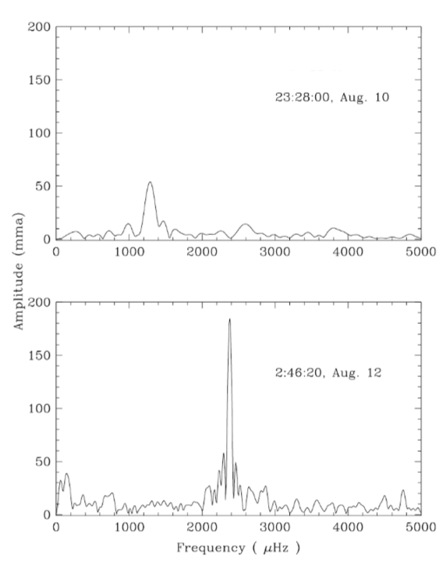
ERAU
EP425 | VARIABLE WHITE DWARF GD358
05
AMPLITUDE SPECTRUM
Observations of GD 358 done one day apart. The top graph shows the results from data collected on the first day of the 3-site campaign in Poland, starting at 23:28:00 UT on August 10. The bottom graph shows the data from McDonald, taken about a day later, starting at 2:48:20 UT on August 12.
Uncertainty of about o.o5μHz
“The Everchanging Pulsating White Dwarf GD358”
Kepler et al.

Slide 8
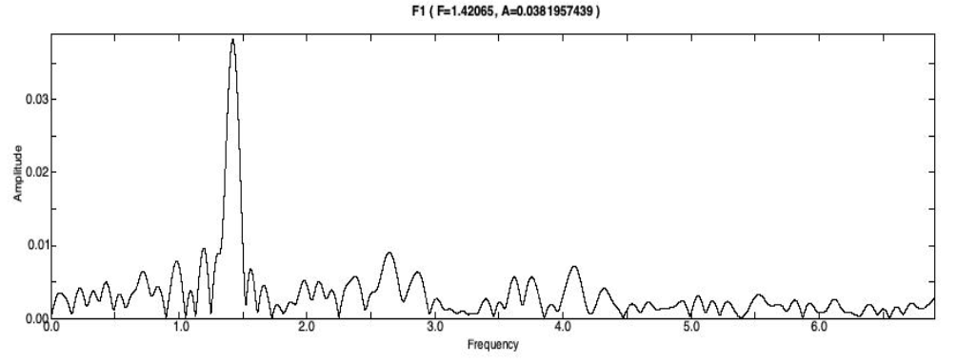
ERAU
EP425 | VARIABLE WHITE DWARF GD358
06
AMPLITUDE SPECTRUM
(mags)
(mHz)

Slide 9
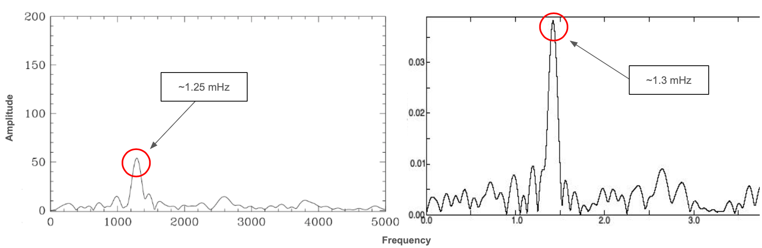
ERAU
EP425 | VARIABLE WHITE DWARF GD358
07
COMPARISON
(mmag)
(mags)
μHz
(mHz)
Mt. Suhora Observatory
ERAU 1-meter Telescope

Slide 10
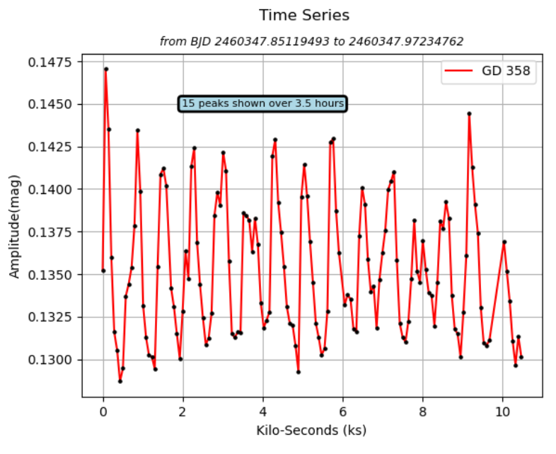
ERAU
EP425 | VARIABLE WHITE DWARF GD358
08

Slide 11
ERAU
EP425 | VARIABLE WHITE DWARF GD358
09
RESULTS
Nr. | Freq. Sigma | Amp. Sigma
F1 | 0.002124817418 | 0.001548214195
F2 | 0.008398613235 | 0.001548214195
F3 | 0.00854413066 | 0.001548214195
F4 | 0.01160184173 | 0.001548214195
F5 | 0.01312782406 | 0.001548214195
We found a period of 697.8s and a frequency and amplitude of about 1.3 mHz and 38.4 mmag, respectively.
Uncertainty values were obtained from Period04; frequency and amplitude sigma values.
Data is based on one night of observations due to complications with the weather and agrees with the referenced papers’ data of GD 358.
Notes:
Jacob stop Laina start

Slide 12
ERAU
EP425 | VARIABLE WHITE DWARF GD358
10
We found results conclusive to the frequency/period found in other studies.
Period ~ 697.8s
Frequency ~ 1.3mHz
Amplitude ~ 38.4mmag
Wide range of periods from 600-800s found for GD358.
Further observations would need to be done to confirm additional frequencies and amplitudes.
CONCLUSION AND FURTHER WORK

Slide 13
REFERENCES
Kepler et al. (2003, January 23). The Everchanging Pulsating White Dwarf GD358. www.arxiv.org. https://arxiv.org/pdf/astro-ph/0301477v1.pdf
Winget, D. E., Robinson, E. L., Nather, R. D., & Fontaine, G. (1982). Photometric observations of GD 358 - DB white dwarfs do pulsate. The Astrophysical Journal, 262. https://doi.org/10.1086/183902
“”AstroImageJ (AIJ) - ImageJ for Astronomy.” Www.astro.louisville.edu,
www.astro.louisville.edu/software/astroimagej
“”AstroImageJ (AIJ) - ImageJ for Astronomy.” Www.astro.louisville.edu, www.astro.louisville.edu/software/astroimagej
“Period04 - Homepage.” www.period04.net, www.period04.net.
Notes:
END

Slide 14



ERAU
EP425 | VARIABLE WHITE DWARF GD358
11
QUESTIONS

